Slide 1

PROJECT
PRESENTATION
SK Broadband x Sungkyunkwan University
구자현
문경진

Slide 2

CONTENTS
K-NN
Recommender System

Slide 3
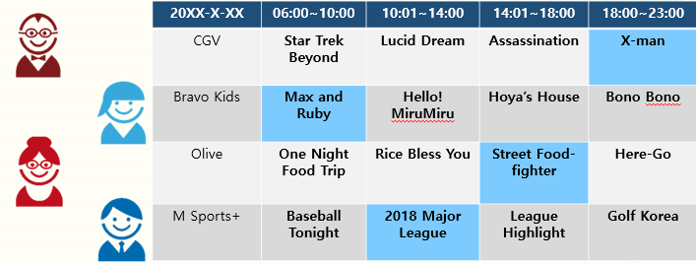
GOAL OF PROJECT

Slide 4
GOAL OF PROJECT
Making recommender system for viewers at particular time periods in succession to previous research
To achieve our goal, we will use watching data of IPTV users.

Slide 5
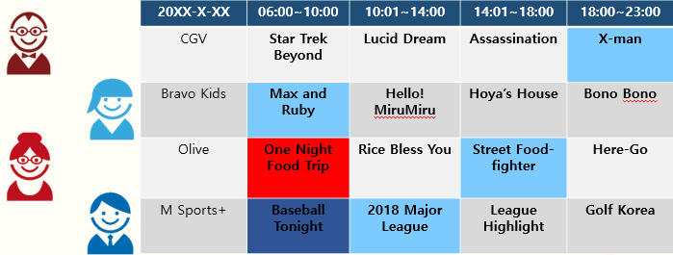
GOAL OF PROJECT

Slide 6
October
Realize channel recommender system based upon clustered data
START
PROJECT
November
System performance evaluation and result analysis

Slide 7
PROCESS
OF OUR
PROJECT
December
FINISH
Suggest improvement point and future direction of research

Slide 8
MAIN TASK
Clustering watching data, using K-means algorithm and K-NN
Implement recommender system using collaborative filtering
Performance checking, drawing conclusion

Slide 9

MAIN TASK
K-NN
Perspective of blue circle (new data)
If k=3, $c∈Green Set$
If k=5, $c∈Yellow Set$
k=5
k=3

Slide 10
MAIN TASK
Recommender System
Subclass of information filtering system that seeks to predict the rating or preference a user would give to an item
Intuition : using similar preference patterns
Using Collaborative Filtering, recommend channel to user!

Slide 11
MAIN TASK
Collaborative Filtering
Given a target user, find a set of users whose preference patterns are similar to the preference pattern of the target user

Slide 12






MAIN TASK
?

Slide 13
MAIN TASK
Using user-item table
 | Search | Monstrum | Along with the Gods | Adrift | The Witness | The spy gone north | Molly’s Game
A | 5 | 2 | - | 1 | - | 5 | 4
B | - | 4 | 4 | - | 1 | 2 | 5
C | - | 4 | 5 | - | 2 | 2 | ?
D | 4 | 2 | - | 1 | - | 5 | ?

Slide 14
CHECKPOINT
Clustering issues
We don’t know that how many people each family has. How to set k value for k-means clustering to detect viewer?
Overlapping or not : Allow data to be included in multiple viewer group?

Slide 15
FINISH
OUR PRESENTATION THANK YOU

